Slide 1
Low Carbon BEST SOLUTION
Advanced eco-friendly sewage and wastewater treatment & water reuse
AGM INC and KAMICO JAPAN.

Slide 2
FOR Earth Life Water
UN Partnership Enterprise
Advanced environmental water treatment Eco-friendly electric carbon catalytic filter and mechanical filtration technology company AGM INC / KAMICO JAPAN Co., Ltd. has developed an “electrochemical carbon electrode” that has changed the paradigm of the ultra-fine filter method using electro carbon catalysts. We use eco-friendly catalytic filter technology to provide clear and clean water for the earth and humanity

Slide 3
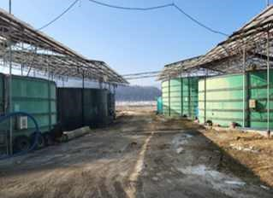
TOC
DOC
Green Algae Growth
Trihalomethanes
Greenhouse
(
THMs
Gas increase
)

Slide 4
Advanced livestock waste processing technology EO-EC Electrocatalyst(oxidation/adsorption/coagulation/sterilization) technology
No more wastewater
Not waster , resources
Compared to high water consumption, the amount of water reuse is small. Unstable water supply and demand due to limited resources and abnormal climate will continue in the future, and advanced water reuse and treatment technologies are being activated to overcome this.

Slide 5
Attempts and failures for advanced treatment of livestock waste and odor
Until now, the process of processing highly concentrated livestock waste has not been easy. Conventional technology has a very long processing speed, resulting in additional costs for civil engineering structures and auxiliary facilities. Eliminates filter loss, excessive energy consumption, and difficulties in operation and maintenance during the main/auxiliary treatment process. This tells us that the main processing process needs to be improved to solve this problem
-,High separation membrane (filter) loss rate
-,High energy expense
-, Difficulties in operation and maintenance
-, Reduce the amount of environmental pollutants generated

Slide 6
-,paradigm
Innovative electrode processing solutions
Low Carbon BEST SOLUTION has an ultra-highly treated
water reuse technology that
can handle high concentrations using
this electrocatalytic electrode system.
-,Biological and not physical or chemical; Electrochemical removal technology
Blue BS customized catalyst electrode, it can be applied to various fields, ensure safe
maintenance, reduce energy, and reduce environmental pollution. It is an eco-friendly
technology.
-, Drug cost 50% Saver
-, Energy usage 20% reduction
-, Safe and efficient Maintenance
-, Reducing carbon emissions Eco-friendly technology

Slide 7
Advanced oxidation EO-EC
Electrocatalyst (oxidation/adsorption/coagulation/sterilization) technology
Low Carbon BEST SOLUTION
A representative company that considers the environment and improves the quality of life through “environmental improvement & technology convergence”. As an environmental specialist company, we will do our best to advance the industry. We provide solutions in various water treatment fields.

Slide 8
-,high concentration low concentration capable of simultaneous processing modular
-,EF electrochemical catalytic filtration syste
-,Livestock manure Advanced processing ICT-based automatic syste
PROCESS
1) Customer
2) Custom consulting
3) Process design
4) PRODUCE
5) Installation & Commissioning

Slide 9
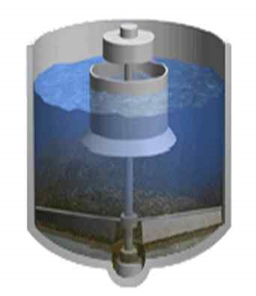
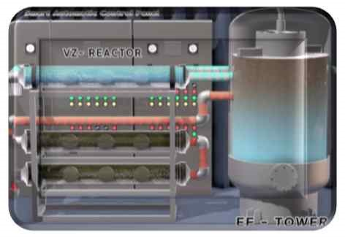
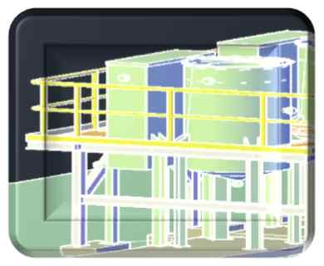
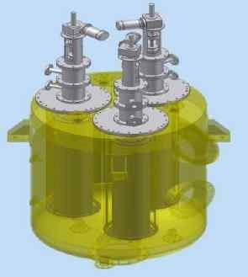
Electrocoagulation Electrode catalyst solid-liquid separation Electrode Catalyst Oxidation filter filtration

Slide 10
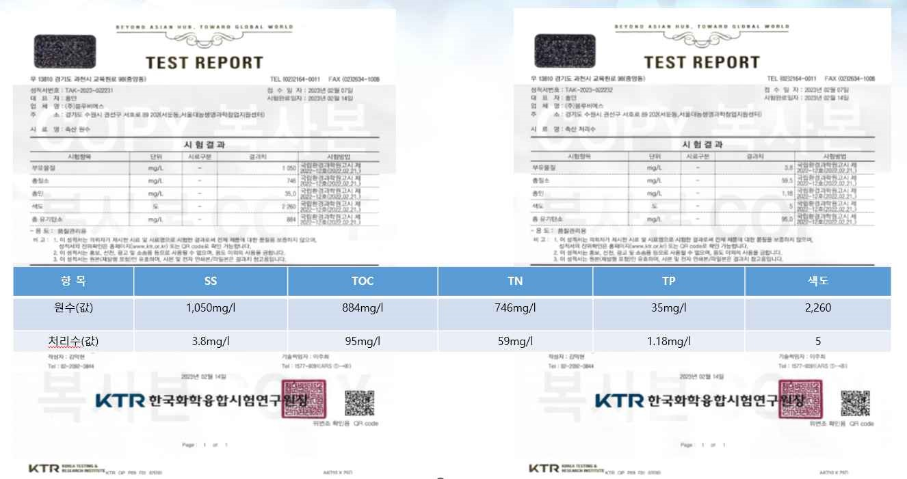
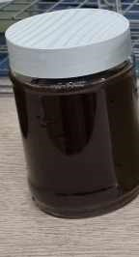
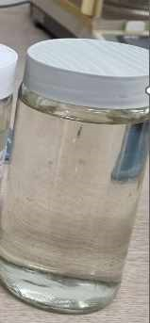

Slide 11
Advanced oxidation EO-EC Electrocatalyst (oxidation/adsorption/coagulation/sterilization) technology
Ø Livestock waste water treatment and odor reduction Ø Nitrogen, phosphorus, TOC, color, odor customized Ø Dedicated system to remove processing
“Electrocatalytic OH radical”

Slide 12
Low-carbon electrolysis waste treatment technology(Highly oxidized E-AOP technology)
1). Advanced treatment technology for sewage and wastewater reuse
2). Livestock manure odor and water treatment technology
3). Leachate wastewater advanced treatment technology
4). mechanical filter technology
5). Agricultural water (urban agriculture) supply filter
manufacturing technology
6). Drinking water/residential water/desalination technology
(WDP)
7). Groundwater/river water/reservoir purification technology

Slide 13
Thank You
AGM INC / KAMICO JAPAN Co.,LTD

